Slide 1
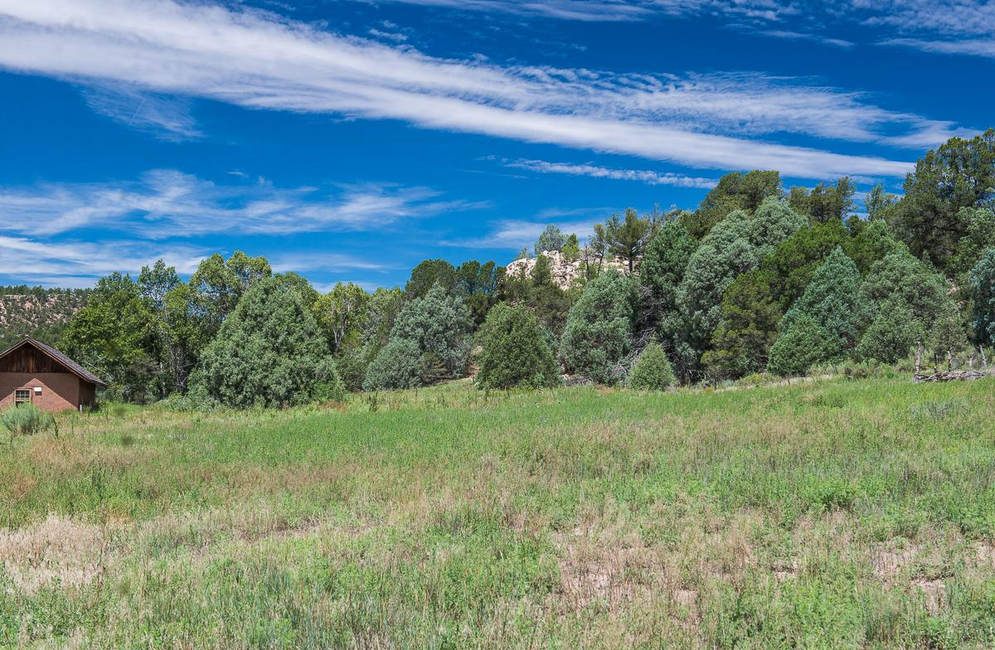
THE SAGE RIDGE REVIEW
The world’s favorite newspaper Since 1965
THE ROUGH WEST
Would you like to learn about the explorers of the United States of America? The Sage Ridge Review would like to tell you about the explorers out west and the difficulties they encountered during the westward expansion of the United States of America. The sources that the review will be using are Lewis and Clark, The Pioneer Woman, and a song called Elbow Room.
The first example is from The Journals of Lewis and Clark. Lewis and Clark were early explorers traveling with a group called The Corps of
Discovery, from 1804-1806. They traveled on the Missouri River and they hired Sacagawea and Charbonneau to be their guides. During this exploration, Lewis and Clark had to go through a tough storm that was ferocious! They were traveling on the water when a storm came and they had to find a safe place for camp. The only place to camp they could find was in shallow water at the mouth of a brook. This kept them cold and wet for weeks. Fortunately after that the men were healthy.
The second example the review would

Slide 2
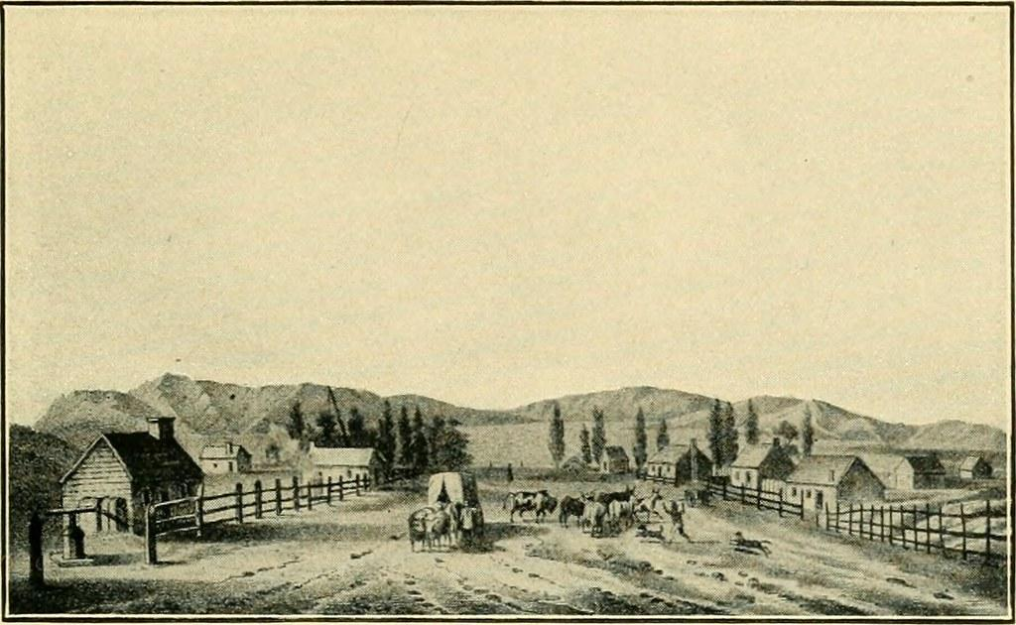
THE ROUGH WEST
The world’s favorite newspaper Since 1965
like to describe for you is from The poem called the Pioneer Woman Looks Back. Marry Stahler, also known as The Pioneer Woman, had to suffer through many hardships when she traveled west in 1849. One hardship was when she was first moving out west and it was hard to say goodbye to her loved ones. She missed her family and wanted a friend to talk to. Another difficulty she had was traveling over the long, hot, and rough trail. Fortunately Mary made it and got the free land she wanted.
The final example the review would like to tell you is about the video called Elbow Room. We learned that the pioneers wanted to move out west.The reason why they wanted to move out west was because they wanted more
land to build new towns and communities. Before they explored new territories, they only had the east coast. They were able to move out west because in 1803 President Thomas Jefferson made a deal with Napoleon. Jefferson purchased the Louisiana Territory for the U.S.A. This provided more land for the explorers.
Finally, as you can see the life of the explorer in the United States of America is tough and challenging. The difficulties of traveling west were the hardships, the tough times and the losses. The difficulties are rough but the wins were worth it.

